Slide 1
A STRIDE-based Security Architecture for Software-Defined Networking
Author: Fabian Ruffy , Wolfgang Hommel and Felix von Eye
Conference: The 15th International Conference on Networks (ICN 2016)
Presenter: Kuan-Chieh Feng
Date: 2016/9/6
Department of Computer Science and Information Engineering
National Cheng Kung University
Notes:
1

Slide 2
Outline
Introduction
Related Work – STRIDE
STRIDE problem and solution in SDN
Design of Secure SDN architecture

Slide 3
Introduction
OpenFlow protocol has become the de facto standard interface between SDN-based control and data planes.
However, security in SDN has been largely neglected, which can be derived from the lack of mutual interoperability of many OpenFlow implementations.
Notes:
功能性與互相作用是vendor最主要的銷售點，因此並沒有特別針對韌體與軟體發展的security做加強

Slide 4
Introduction
In this paper, the well-known STRIDE threat model is applied to the SDN concepts as a basis for the design of a secure SDN architecture.

Slide 5
Related Work – STRIDE
STRIDE
Spoofing
Tampering
Repudiation
Information Disclosure
Denial of Service
Elevation of Privilege

Slide 6
Related Work – STRIDE
Spoofing
Allows attackers to fool a system and to conceal or fake their identity. Spoofing is frequently enabled by a lack of proper authentication and verification.
Tampering
Intruders are able to compromise the integrity of transported or stored data. A malicious user could potentially alter or delete information to his advantage, without triggering an alarm or being noticed by the owner.
Notes:
假冒身份 - 假冒意味在電腦上模仿別人。非法存取然後使用其他使用者的驗證資訊 (例如使用者名稱和密碼)，即是假冒身份的範例。
竄改資料- 資料竄改牽涉到惡意修改資料。例如，未授權變更永久資料 (例如資料庫所保留的資料)，以及當資料在開放網路 (例如網際網路) 上的兩部電腦之間流動時加以變更。

Slide 7
Related Work – STRIDE
Repudiation
Logs and tracking systems are incomplete and can not accurately identify the perpetrator.
Information Disclosure
By abusing a vulnerability, a system might reveal sensitive data or passwords to an attacker. Eavesdropping is often correlated with preparing a sophisticated Spoofing or Tampering attack.
Notes:
否認 - 否認威脅包括使用者不需經過第三方任何驗證，就能拒絕執行動作。例如，使用者可在無法追蹤禁止作業的系統中，執行非法作業。
藉由相同的 Token，「不可否認性」指的是系統解決否認威脅的能力。例如，使用者可能需要在收到購買的項目時簽名。之後廠商可使用已簽名的收據，做為使用者確實收到貨品的證明。
資訊洩露 - 資訊洩露威脅是將資訊洩露給沒有存取權限的個人，例如，讓沒有讀取權的使用者讀取檔案，或讓入侵者讀取兩部電腦間正在傳輸的資料。

Slide 8
Related Work – STRIDE
Denial of Service
Assets may be subject to an attack, which renders the service or system temporarily unusable to customers or users.
Elevation of Previlege
This vulnerability often stems from a lack of access control. A simple user or client is able to escalate his authority in the system, which provides them with the capability to freely access restricted or classified assets.
Notes:
拒絕服務 - 拒絕服務 (DoS) 攻擊會藉由一些方法 (例如，讓 Web 伺服器暫時無法取得或使用)，使有效使用者無法使用某些服務。您必須防護特定類型的 DoS 威脅，才能增進系統的可用性和可靠性。
提高權限 - 在此類威脅中，無權的使用者可取得存取權限，因此有足夠的存取權限可危害或摧毀整個系統。提高權限威脅包含下列情況：攻擊者有效滲透所有系統防線，並使其本身成為受信任系統中的一員。

Slide 9
STRIDE problem and solution in SDN
STRIDE threat and solutions in SDN
Spoofing
Problem - Illegitimate authentication as controller, switch or application due to negligent security measures and software faults.
Solution - Enforce mandatory and modern authentication procedures in the standard works. Ensure trustworthiness of remote or local application commands.

Slide 10
STRIDE problem and solution in SDN
STRIDE threat and solutions in SDN
Tampering
Problem - Attacker may be able to overwrite controller policy and poison the central, virtual network view. The interception and altering of OpenFlow control messages has an extensive impact on the network configuration.
Solution - Implement access-control and integrity-verification mechanisms in the north- as well as the southbound interface of SDN. Significant actions are decided based on the votes of multiple, independent control elements.

Slide 11
STRIDE problem and solution in SDN
STRIDE threat and solutions in SDN
Repudiation
Problem - Lack of inherent and automatic monitoring capabilities of switches and control software may enable covert operations.
Solution - SDN devices are uniquely identifiable. Logging and tracking mechanisms are automatic and secured.
Notes:
SDN網路內部的device本身就已經是可以辨識的，因此就不會有repudiation的問題

Slide 12
STRIDE problem and solution in SDN
STRIDE threat and solutions in SDN
Information Disclosure
Problem - The centralised information storage and query possibilities simplify network reconnaissance.
Solution - Relocate SDN communication to separate and secured channels, the controller and the network data storage are removed from the data net.
Notes:
當整個網路的資料都儲存在controller，很容易就會洩漏

Slide 13
STRIDE problem and solution in SDN
STRIDE threat and solutions in SDN
Denial of Service
Problem - Switch functionality is dependent on a single, central controller and control channel which is susceptible to multitude of attack possibilities, such as flooding, exploits and software bugs. The routing tables of switches are limited and quickly exhaustible.
Solution - Deploy controller paired with intrusion-detection mechanisms and utilise fall-back mechanisms and element redundancy.
Notes:
Switch的功能仰賴於中央式的controller，因此容易遭受攻擊。而routing table遭受DoS攻擊時也容易就會爆掉
或是使用備份機制

Slide 14
STRIDE problem and solution in SDN
STRIDE threat and solutions in SDN
Elevation of Previlige
Problem - Network controllers accessible to multiple users may be compromised or expose information about neighbour networks. As there is no distinction in the priority of the application commands, malicious client applications may assume full authority of a shared controller.
Solution - Shared resources must be subject to rigorous role-based access-control and separation mechanisms, while clients receive minimal trust in their operations.

Slide 15
Design of a Secure SDN architecture
The first and absolute prerequisite in the secure system is the use authenticity and integrity for any device communication in the network.
To avoid dependency on a single device, at least two independent controllers should be deployed in the network.
Notes:
- 網路中所有application controller與switch之間的溝通必定要經過共同認證，這樣才能夠保護一些機密的資訊
- 至少兩個controller可以在其中一個失去功能時接管整個網路

Slide 16
Design of a Secure SDN architecture
The control plane resides in a protected area, similar to a vital database in a conventional network.
Any traffic which is not a OpenFlow communication message is filtered using the integrated flow table firewalls.
Administrator applications report the state and log of all controllers and switches in the network and track actions of the single devices and applications.
Notes:
Control plane會放在一個受保護的區域內，只有經過認證的host才能夠存取server。而不屬於OF communication message的traffic會被FW過濾掉，這樣可以用來阻擋DoS

Slide 17
Design of a Secure SDN architecture
To quickly identify and resolve attacks in the entire network, switches could mirror traffic to selected inspection servers.
The detection systems report the results to the controller, which swiftly reconfigures the network to isolate the affected sections.
The controller might be capable of identifying suspicious network behaviour based on packet patterns.

Slide 18
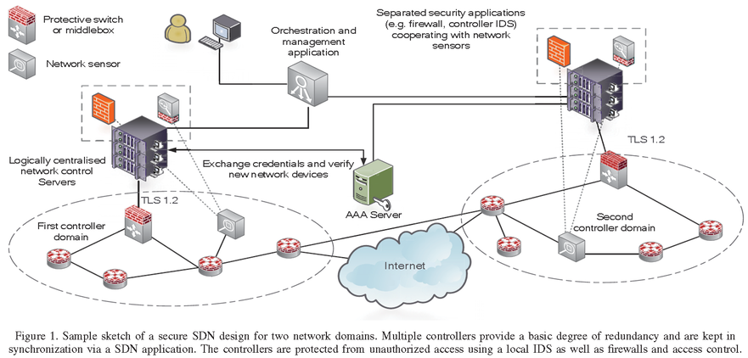
Design of a Secure SDN architecture
Notes:
將多個controller放在受保護的區域(包含access control及firewall)
想要存取Server zone的application或是host需要使用AAAserver及control algorithm並透過location及identity來辨識
而network sensor同時可以mirror traffic到IDS提供detect

